Slide 1
Iteration until convergence
How many resampling iterations will it take until an array of N different values will converge to the same value?

Slide 2
Visual representation
1
2
3
1
2
2
1
1
1

Slide 3
Walkthrough
Start with this initial array:
1 2 3 4 5 6 7 8 9 10
It has
N=10 unique values.

Slide 4
Sample with replacement from the previous array
1 2 3 4 5 6 7 8 9 10
1 2 3 3 5 6 7 7 9 10
2 2 3 3 3 6 7 7 9 9
….
7 7 7 7 7 7 7 7 7 7

Slide 5
Summary
Array | iterations
1 2 3 4 5 6 7 8 9 10 | Original (0)
1 2 3 3 5 6 7 7 9 10 | 1
1 2 5 5 5 6 6 7 9 9 | 2
1 1 5 5 5 5 5 5 6 9 | 3
5 5 5 5 5 5 5 5 5 5 | . . . Converged (i)
Converged value: 5 Iteration: i Sample size: 10

Slide 6
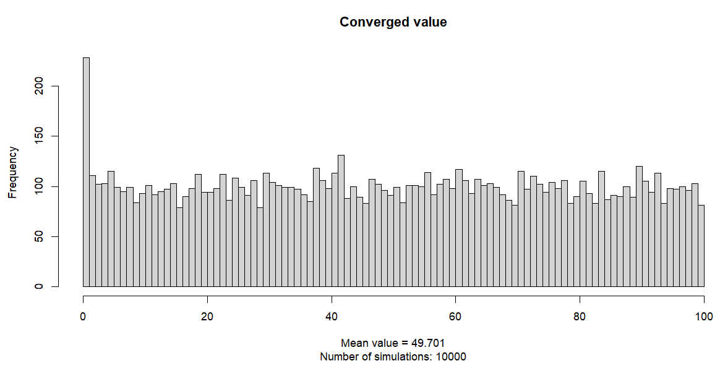
The converged value is uniformly distributed

Slide 7
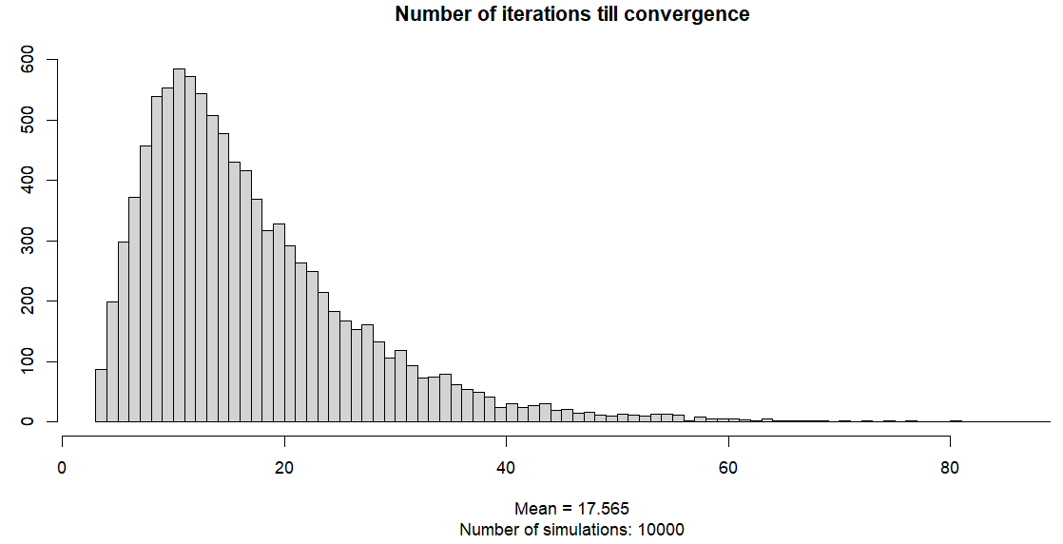
10,000 simulations resulted in mean iteration = 17.6 times

Slide 8
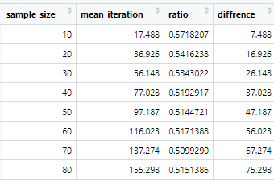
Some more findings..
Another interesting finding is a constant ratio between N and I,
That is the size of the array and the number of iterations it took to converge on a single value.

Slide 9
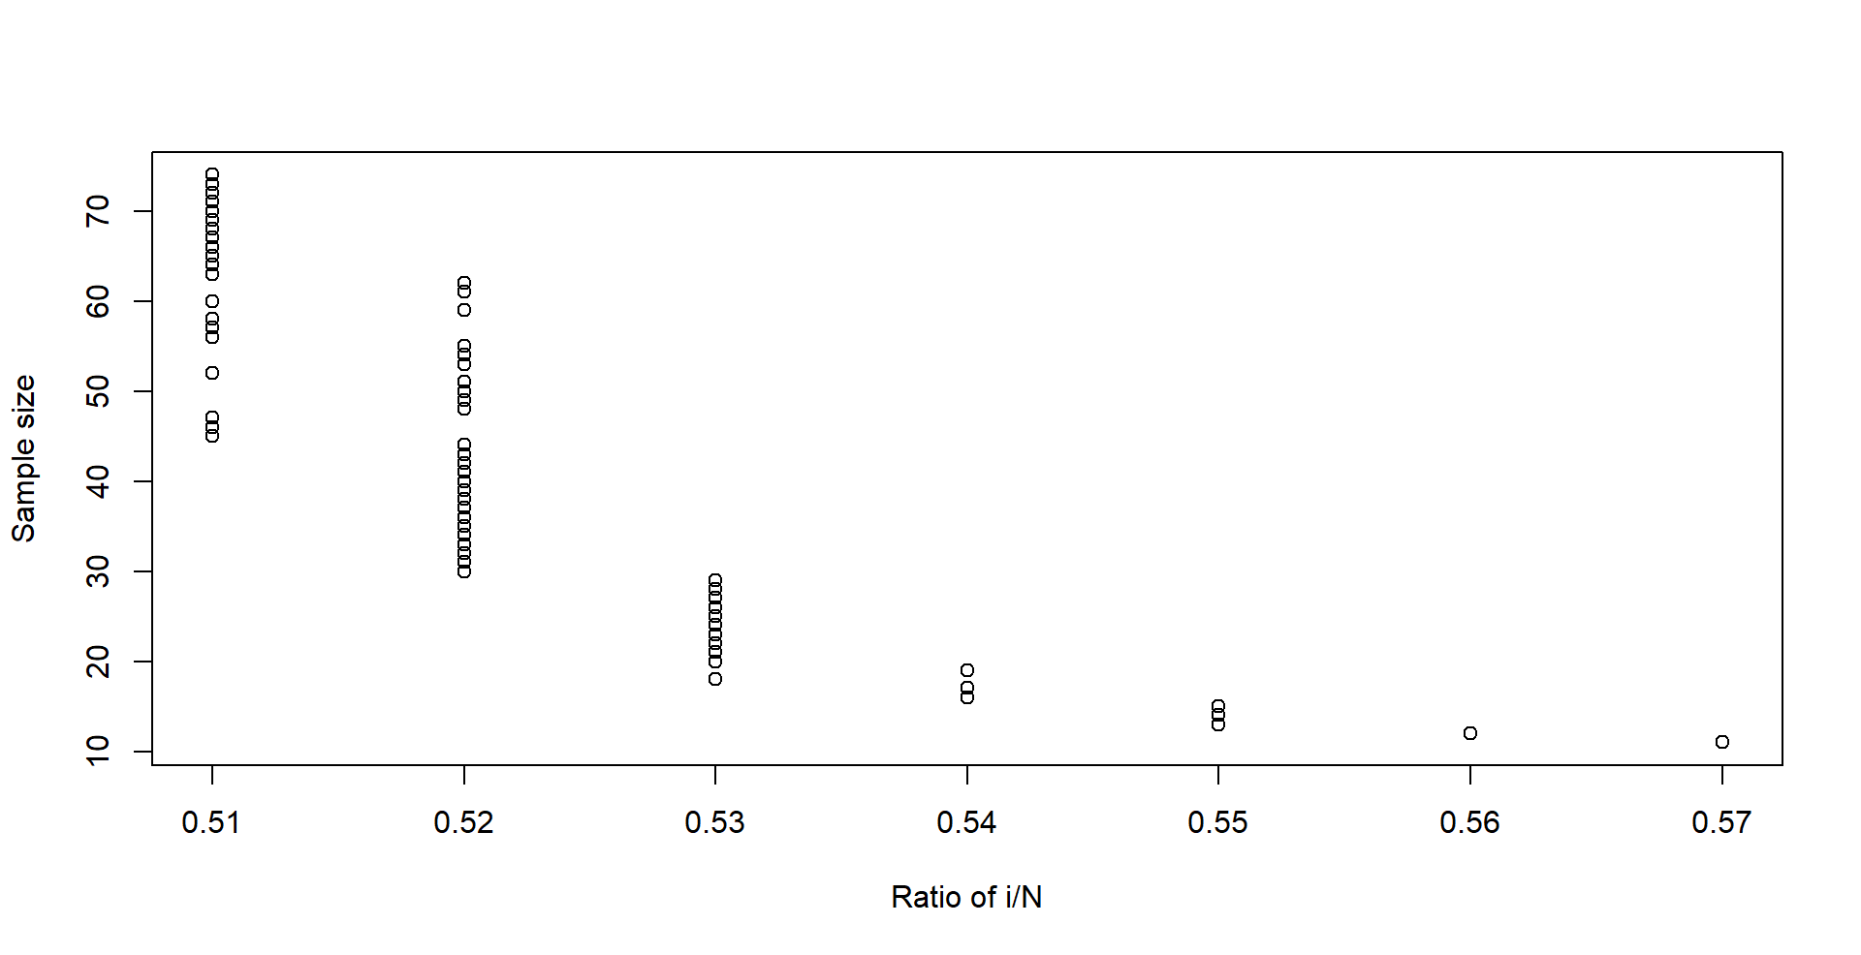
Some more findings..
Roughly N/I = 0.52
*The ratio decreases the larger the N
Or: Iterations = 2*N

Slide 10
Conclusion
In a completely random process, the number of resampling iterations from an array of size N unique values, is roughly twice the size of the array.

Slide 11
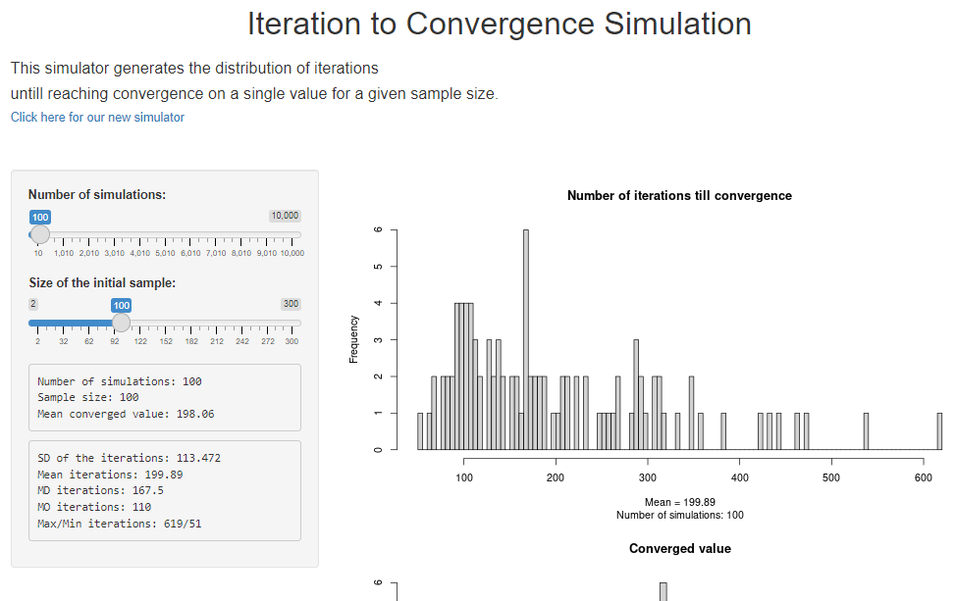
Try yourself
https://yannapps.shinyapps.io/resampling/

